Slide 1
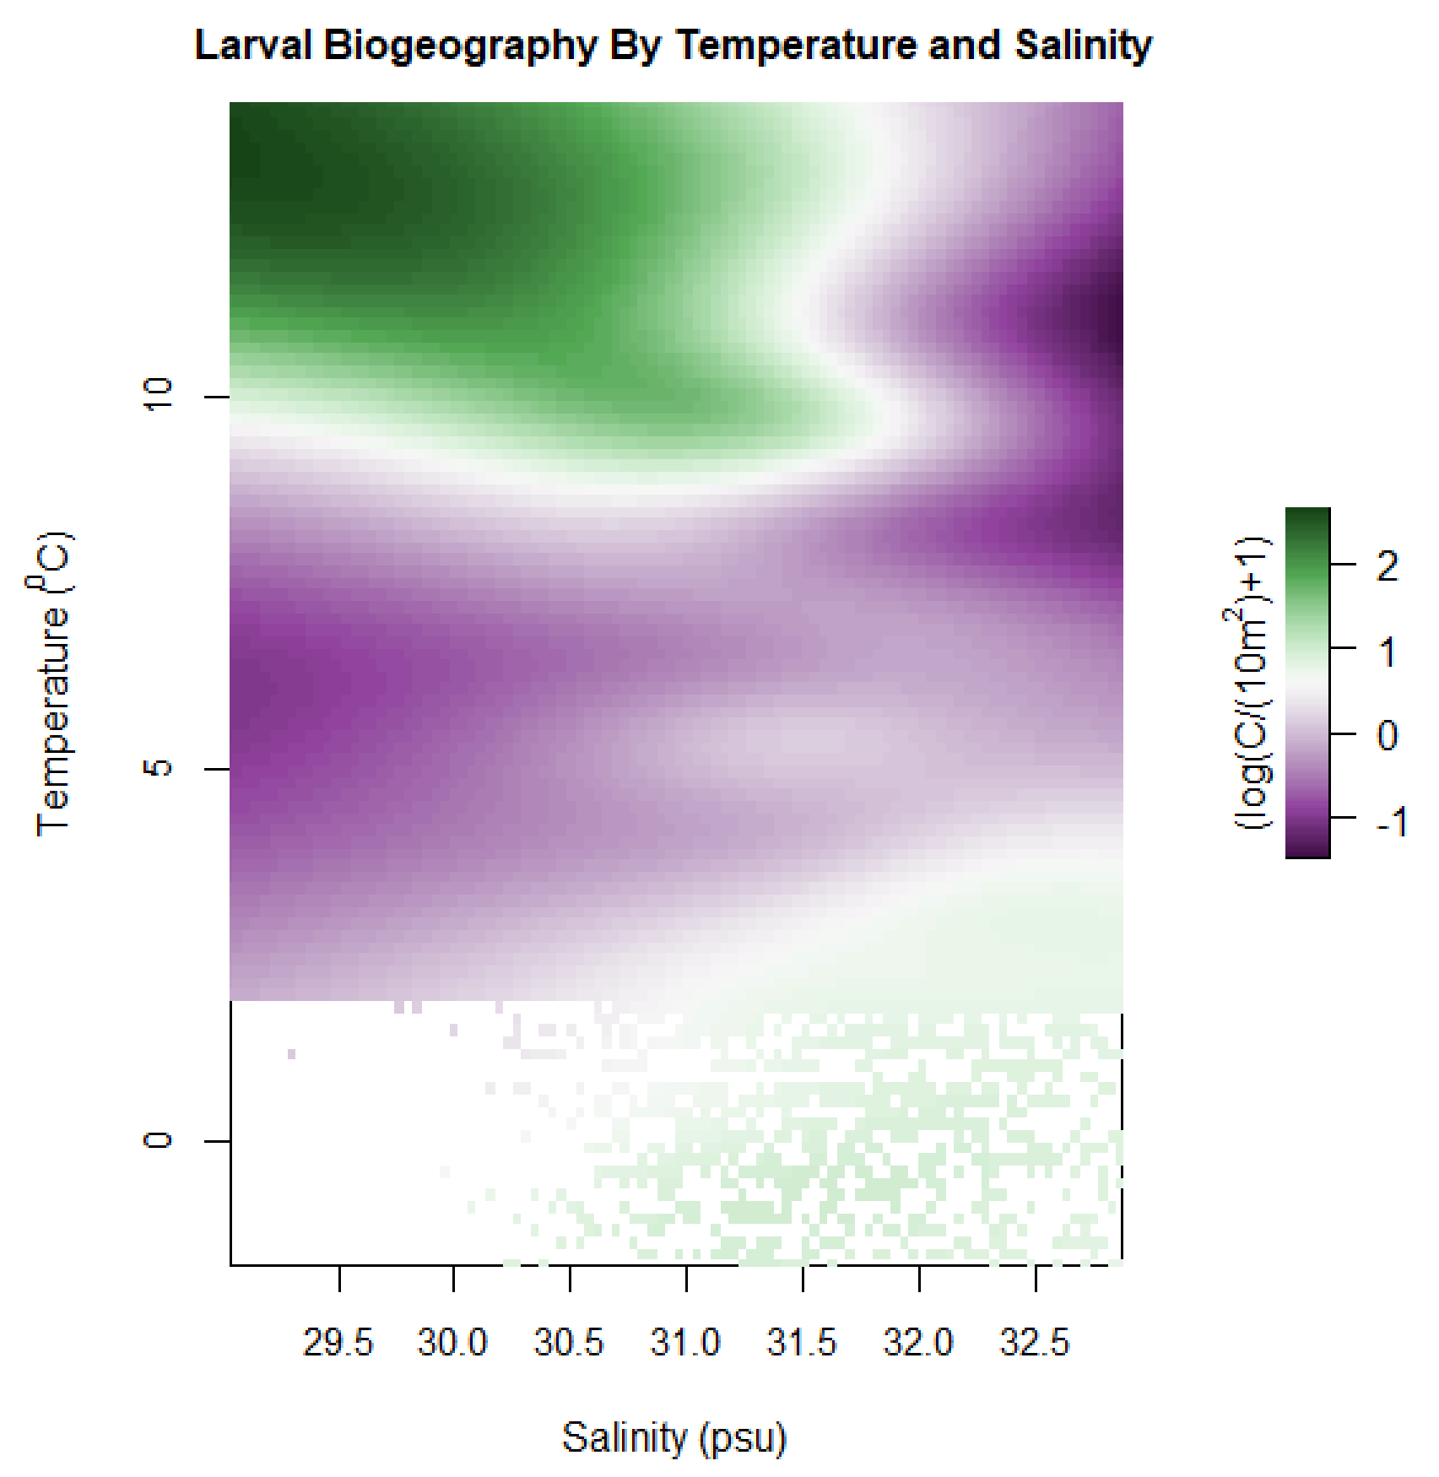
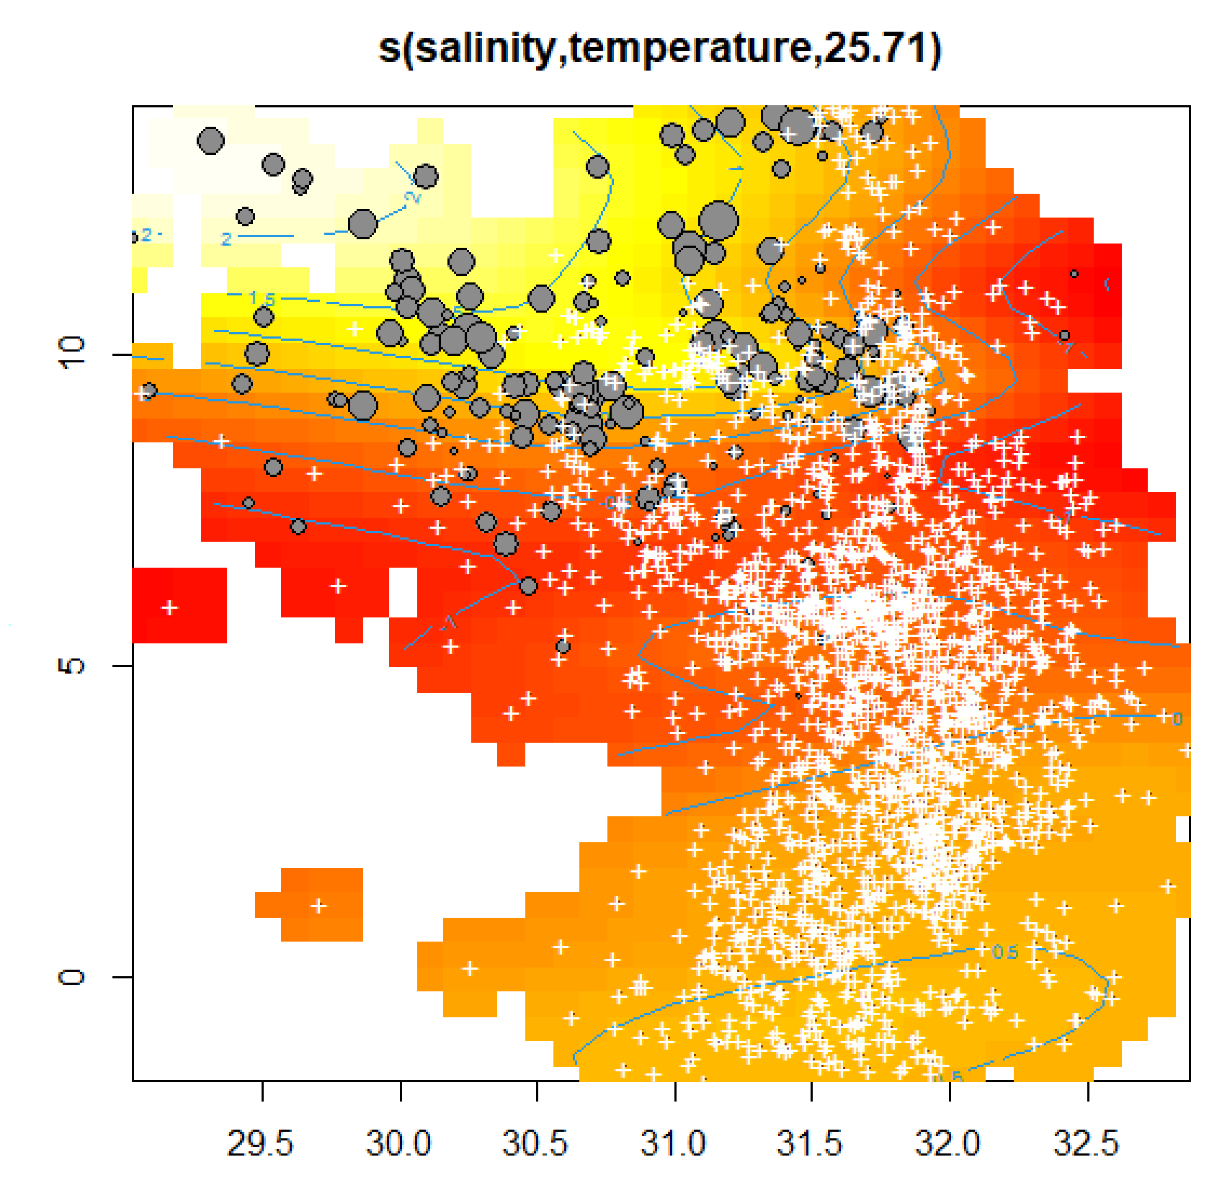
Yellowfin sole

Slide 2
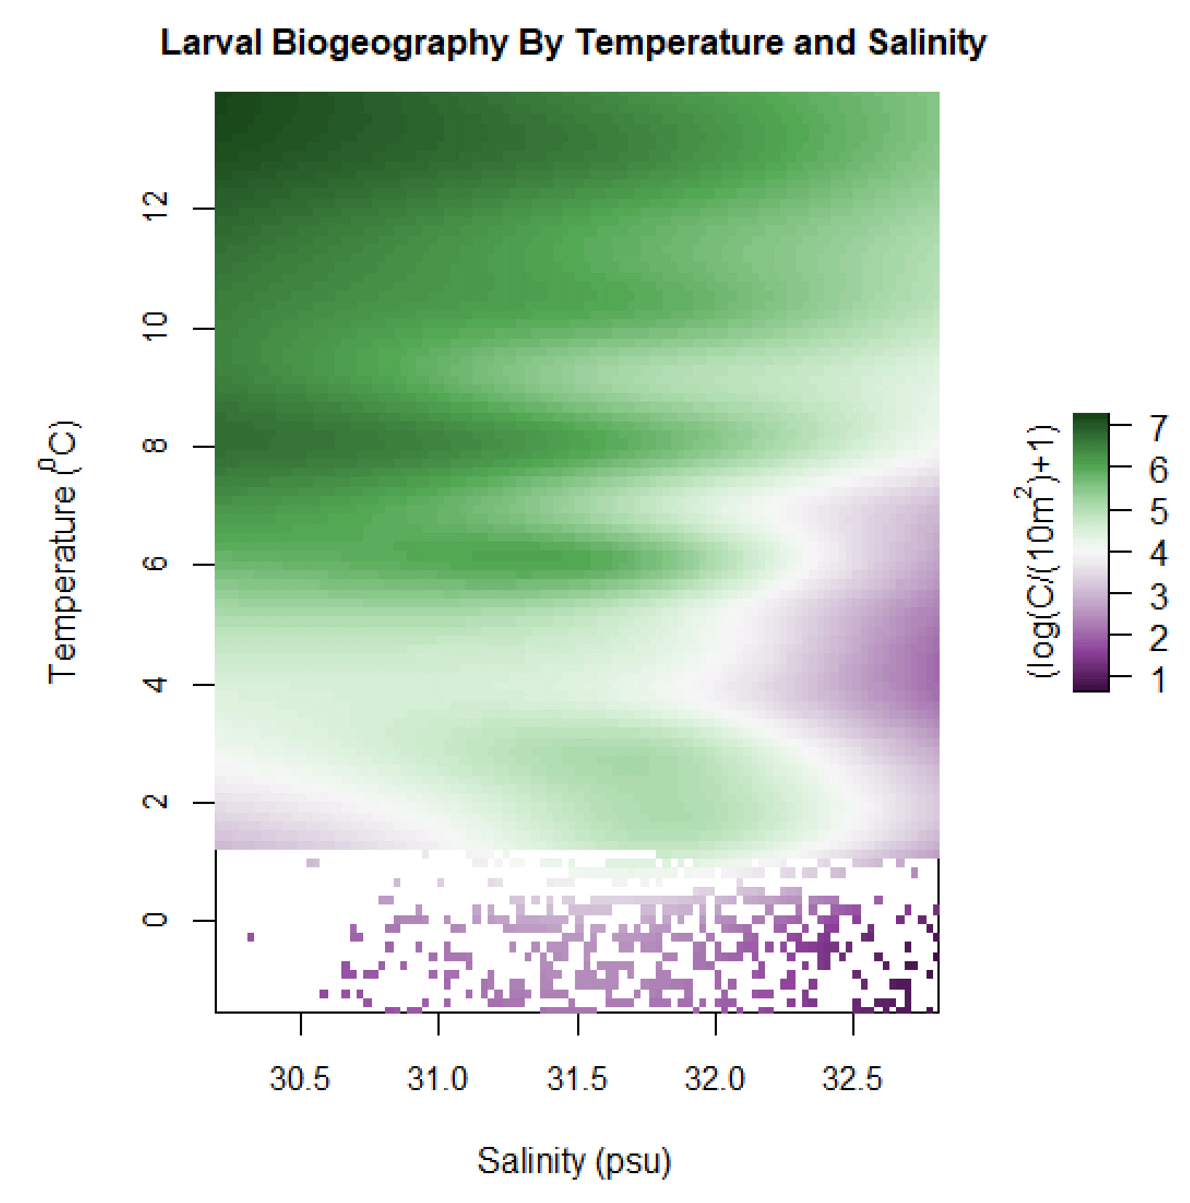
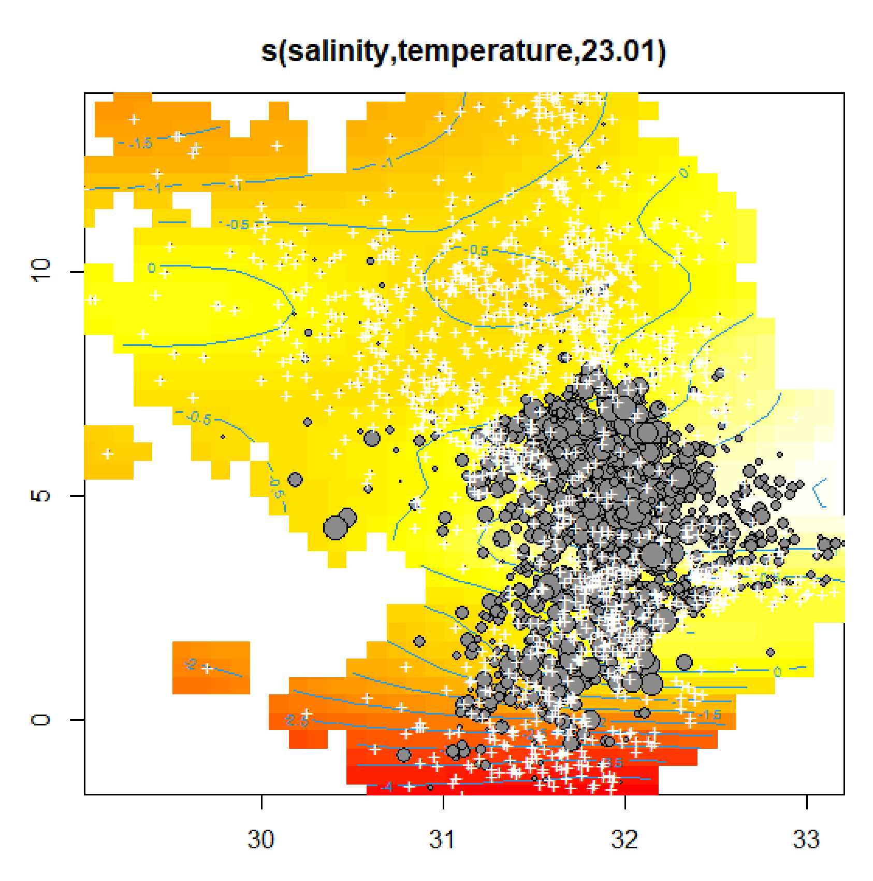
Flathead sole

Slide 3
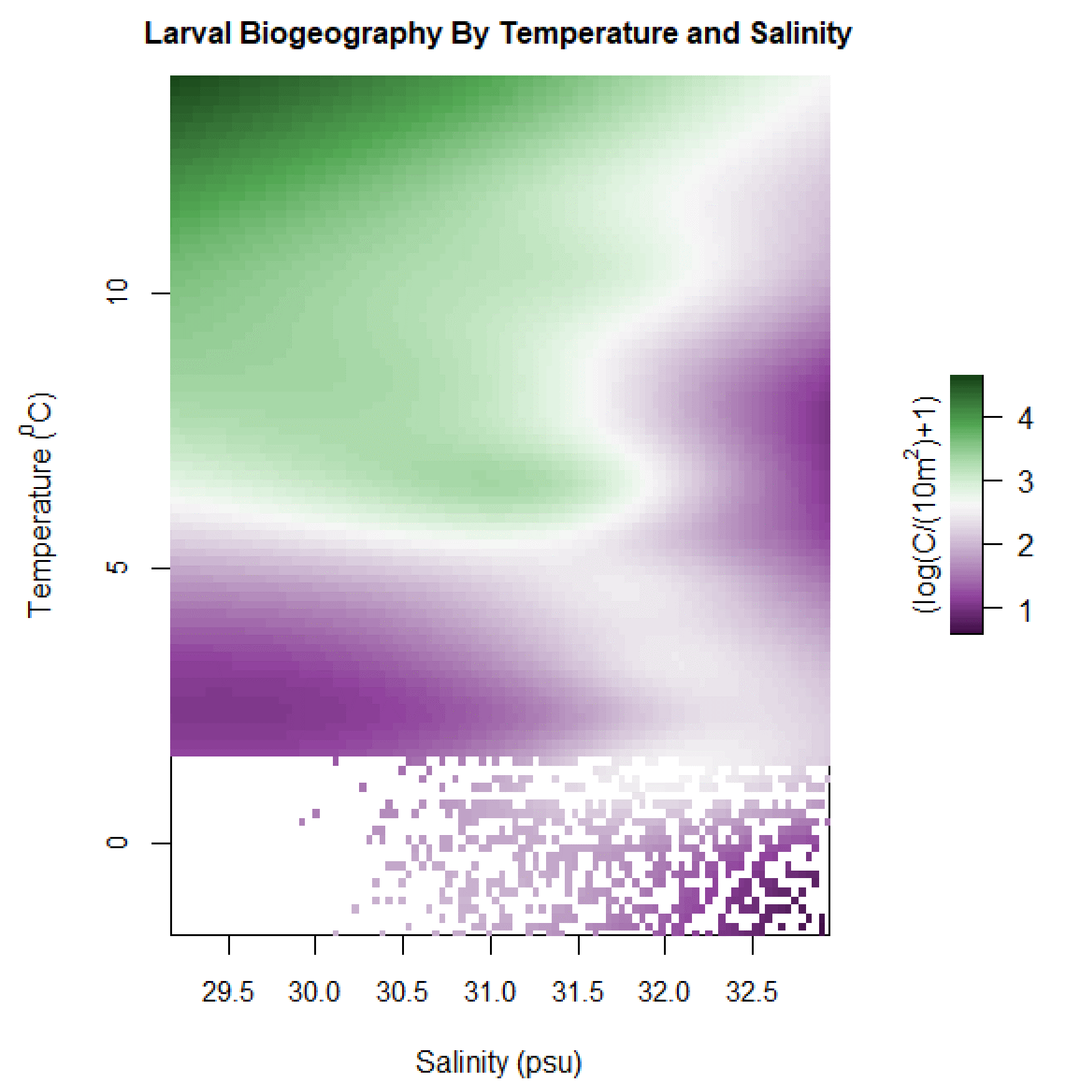
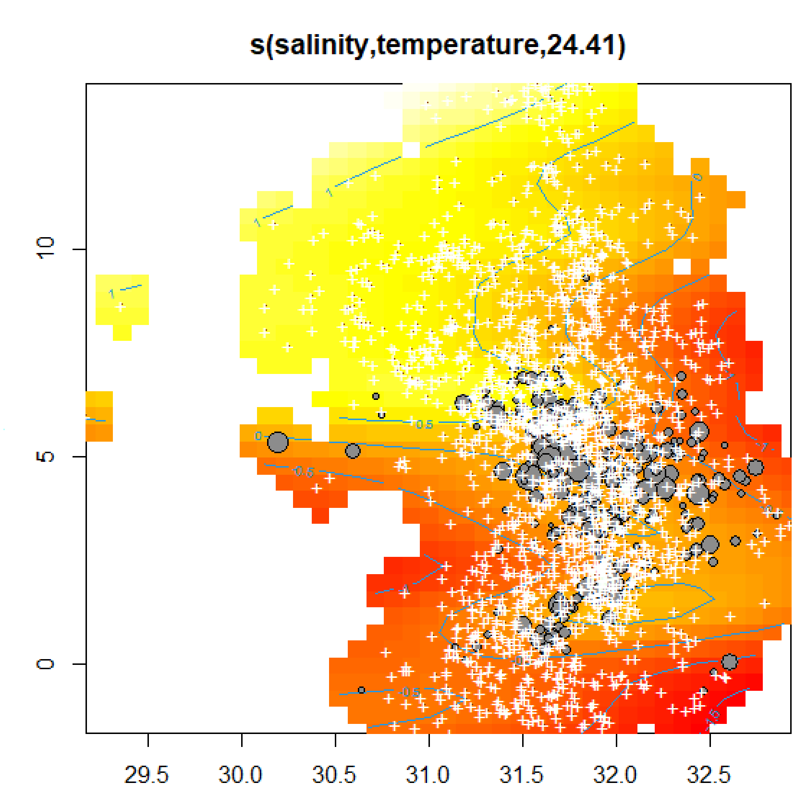
Pacific cod

Slide 4
Alaska plaice
Notes:
NOTE; wait on updating these until Lorenzo gets back w Euclidean distance improvements

Slide 5
Northern rock sole

Slide 6
Walleye pollock

